Slide 1
Agro peddle
Presented by : Srujal S. Shinde

Slide 2
Introduction
Agriculture is something that people have started to become lethargic on, forgetting that it is what is keeping us alive. But there are still hardworking, passionate farmers whose life runs on just farming. But there’s also the corruption that’s increasing a lot nowadays.
In order to avoid this corruption there has to be direct relationship and communication between the farmers and customers. The vision of this project is to ensure fair price to the farming community by providing new techniques and by making use of online market.

Slide 3
Abstract
Agricultural selling still continues to be in an exceedingly dangerous form in rural India. The farmers have to rely on native traders and middlemen for the disposal of their farms products.
As there are many intermediators in between, farmers does not get profitable price for their produce.
Though farmers try to sell their products on online platforms, due to quality and freshness issue many consumers did not buy them.
Our proposed system will overcome both the problems of farmers as well as consumers.
Our aim is to provide ease of buying agricultural products at great price with assurance about freshness and help farmers.

Slide 4
Problem Statement
In case of agricultural goods, farmer does not decide the price at which his product would be sold to the ultimate consumer. It is only the intermediaries who determine the final price in marketing. Agricultural goods, perhaps have the longest chain of middlemen.
Thus, the high price paid by the consumer does not reach the grower. It is pocketed only by the market intermediaries. To overcome this problem, we are going to provide platform for selling the agricultural goods with great profit.

Slide 5
Literature survey
SR. No | Title | Author | Publisher and YOP | Seed Idea/Work Description
1. | Agriculture marketing using web and mobile based technologies. | Abhishek A. G. Bharathwaj M. Bhagyalakshmi L. | IEEE 2016 | Ensure fair price to the farming community by devising new techniques and by making use of online market.
2. | Innovation of E-commerce fresh agricultural products. | Lan Li Yingzhang Miao | Reasearchgate.net 2017 | Use effectiveness of E-commerce to increase income of farmers.
3. | Fruit and vegetable identification using machine learning. | Frida Femling Adam Olson Fernando Alonso-Fernandez | Researchgate.net 2018 | Developing a system identifying fruit and vegetable using image captured with a camera.

Slide 6
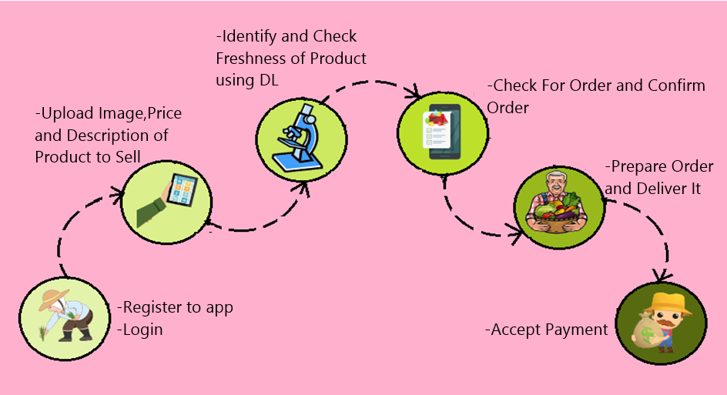
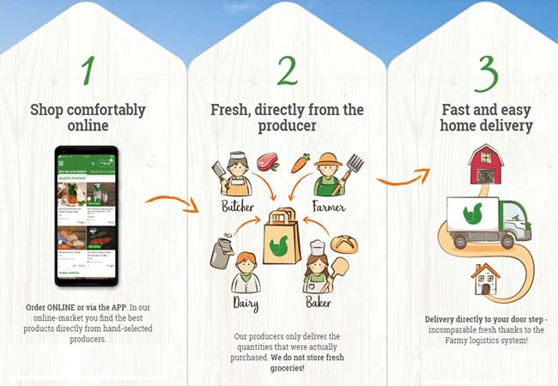
METHODOLOGY

Slide 7


Work till date
Log in for user/customer

Slide 8

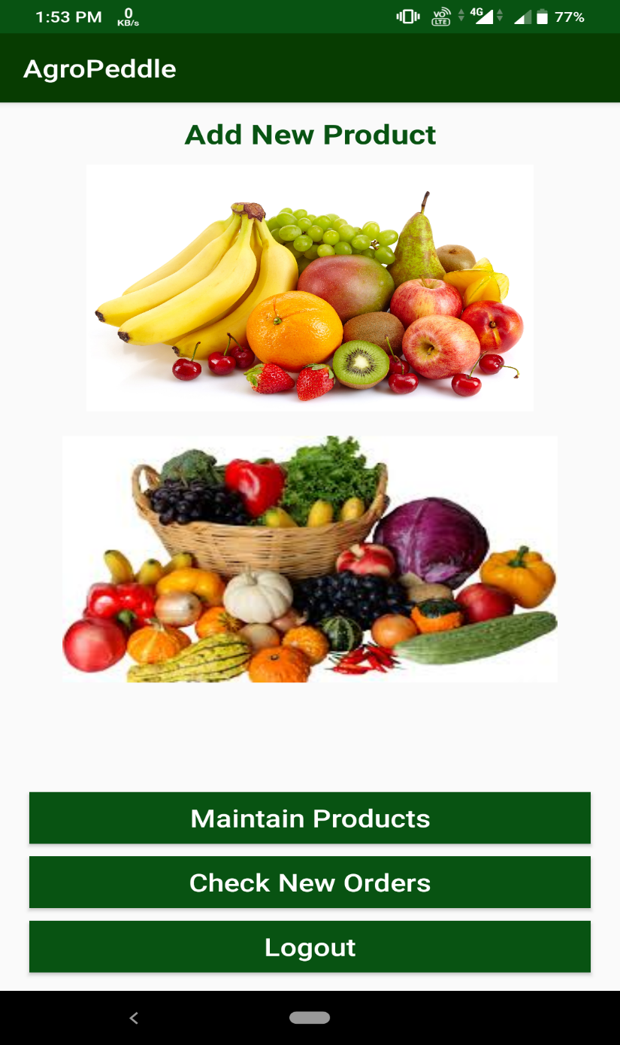

Slide 9
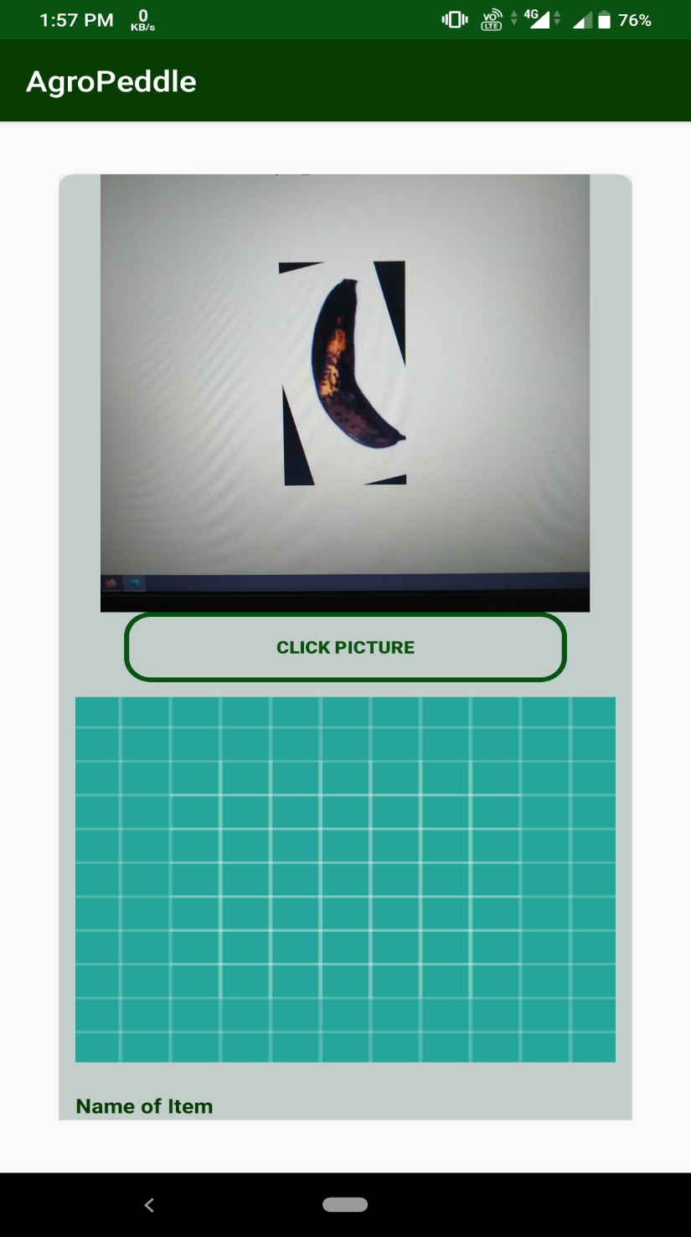
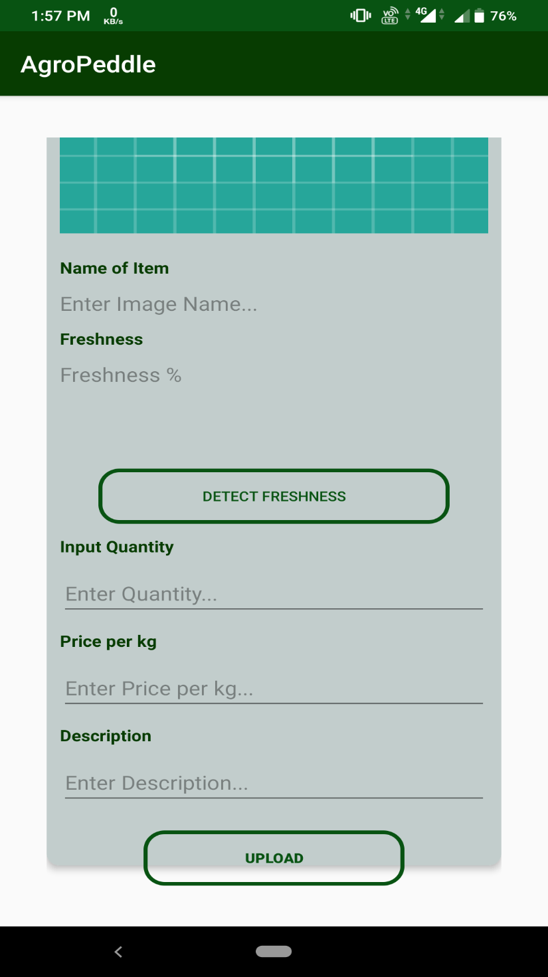

Slide 10
